Slide 1
BLM1612 - Circuit Theory
Prof. Dr. Nizamettin AYDIN
naydin@yildiz.edu.tr
www.yildiz.edu.tr/~naydin
Linearity
Superposition
Thévenin’s and Norton Theorems
Mesh Analysis
Maximum Power Transfer Theorem

Slide 2
Objectives of Lecture
Introduce the property of linearity
Introduce the superposition principle
Provide step-by-step instructions to apply superposition when calculating voltages and currents in a circuit that contains two or more power sources.
Describe the differences between ideal and real voltage and current sources
Demonstrate how a real voltage source and real current source are equivalent so one source can be replaced by the other in a circuit.
State Thévenin’s and Norton Theorems.
Demonstrate how Thévenin’s and Norton theorems can be used to simplify a circuit to one that contains three components: a power source, equivalent resistor, and load.
Understand Maximum Power Transfer Theorem

Slide 3
Linearity
A Requirement for Superposition

Slide 4
Linear Systems
The homogeneity property requires that if the input (also called the excitation) is multiplied by a constant, then the output (also called the response) is multiplied by the same constant.
If x is doubled,
y = f(2Xx) = 2f(x)
If x is multiplied by any constant, a
y = f(ax) = af(x)
then the system is linear.
x
Linear Circuit
y = f(x)

Slide 5
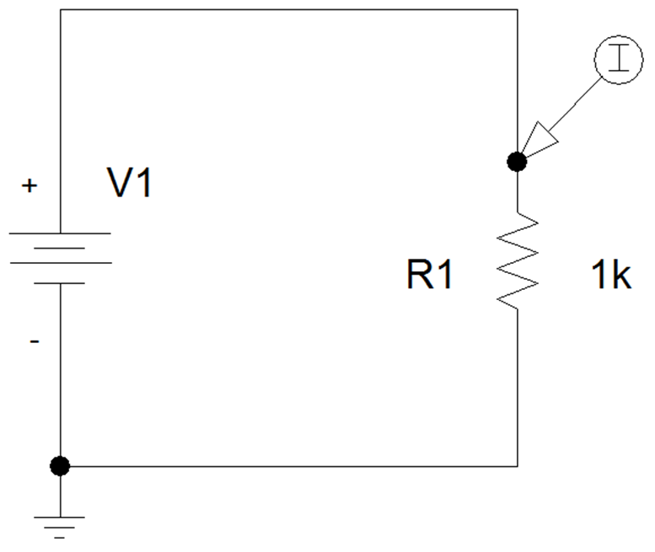
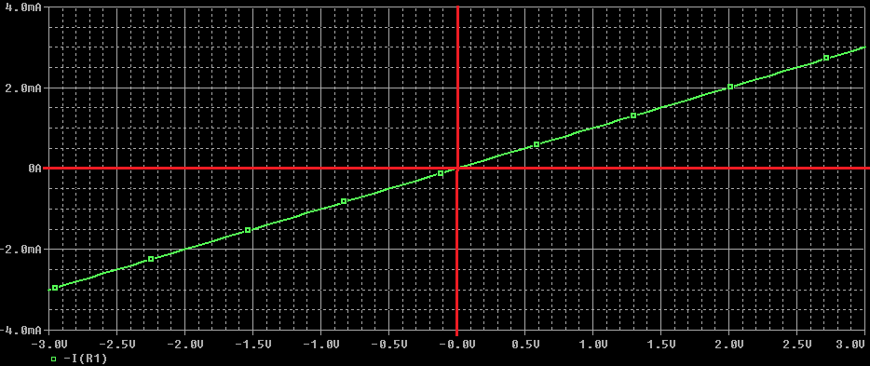
Linearity
Ohm’s Law is a linear function.
V = I×R
If the current is increased by a constant k, then the voltage increases correspondingly by k;
k×I×R = k×V
Example: DC Sweep of V1

Slide 6
Linearity
The additivity property requires that the response to a sum of inputs is the sum of the responses to each input applied separately.
If x = x₁ + x₂
y = f(x) = f(x₁ + x₂) = f(x₁)+ f(x₂)
then the system is linear.
Using the voltage-current relationship of a resistor, if
V₁ = I₁×R and V₂ = I₂×R
then applying (I₁+ I₂) gives
V = (I₁+ I₂) ×R = I₁×R + I₂×R = V₁ + V₂

Slide 7
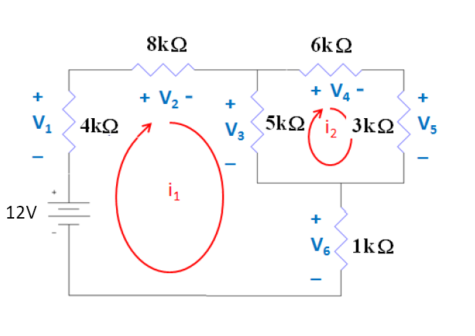
Mesh Analysis is Based Upon Linearity
V₃ = 5kΩ (i₁ – i₂ ) = 5kΩ i_{i} – 5kΩ i₂

Slide 8
Nonlinear Systems and Parameters
In a linear resistive circuit power is
P = IV
Is power linear with respect to current and voltage?
Power is nonlinear with respect to current and voltage.
As either voltage or current increase by a factor of a, P increases by a factor of a².
P = IV = I²R = V²/R

Slide 9
Linear Components
Resistors
Inductors
Capacitors
Independent voltage and current sources
Certain dependent voltage and current sources that are linearly controlled

Slide 10
Nonlinear Components
Diodes including Light Emitting Diodes
Transistors
SCRs
Magnetic switches
Nonlinearily controlled dependent voltage and current sources

Slide 11
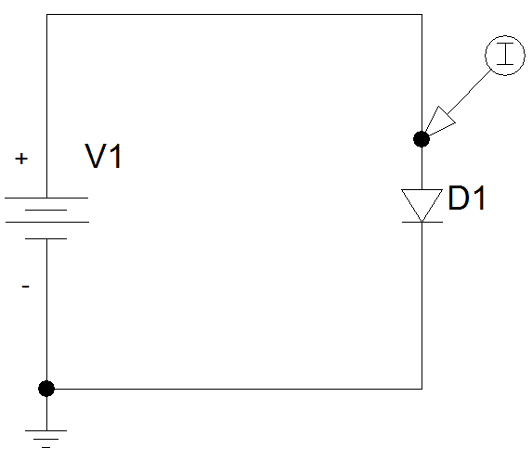
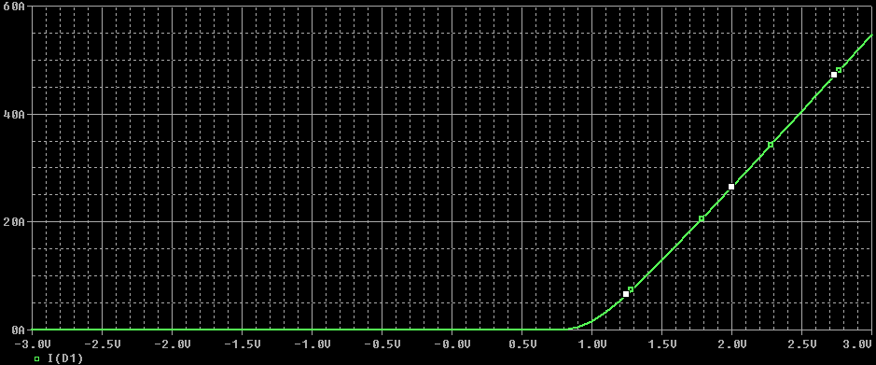
Diode Characteristics
An equation for a line can not be used to represent the current as a function of voltage.

Slide 12
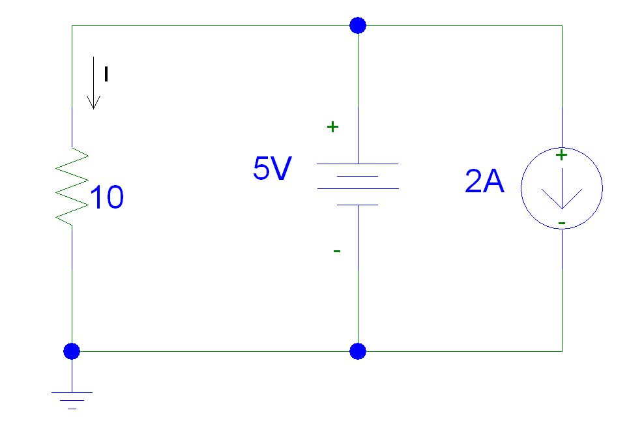
Example 01…
Find I
This circuit can be separated into two different circuits
one containing the 5V source
the other containing the 2A source.
When you remove a voltage source from the circuit, it should be replaced by a short circuit.
When you remove a current source from the circuit, it should be replaced by an open circuit.

Slide 13
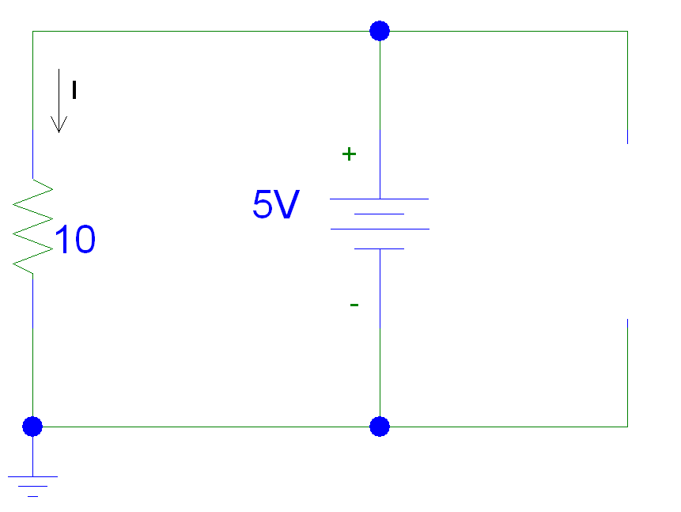
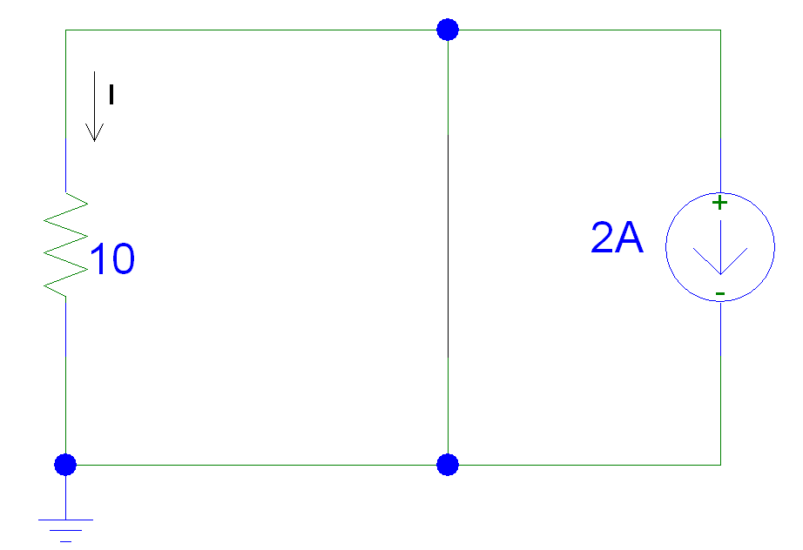
…Example 01…

Slide 14
…Example 01…
I₁ = 5V/10Ω = 0.5A
I₂ = 0A
I = I₁ + I₂ = 0.5 + 0 = 0.5A

Slide 15
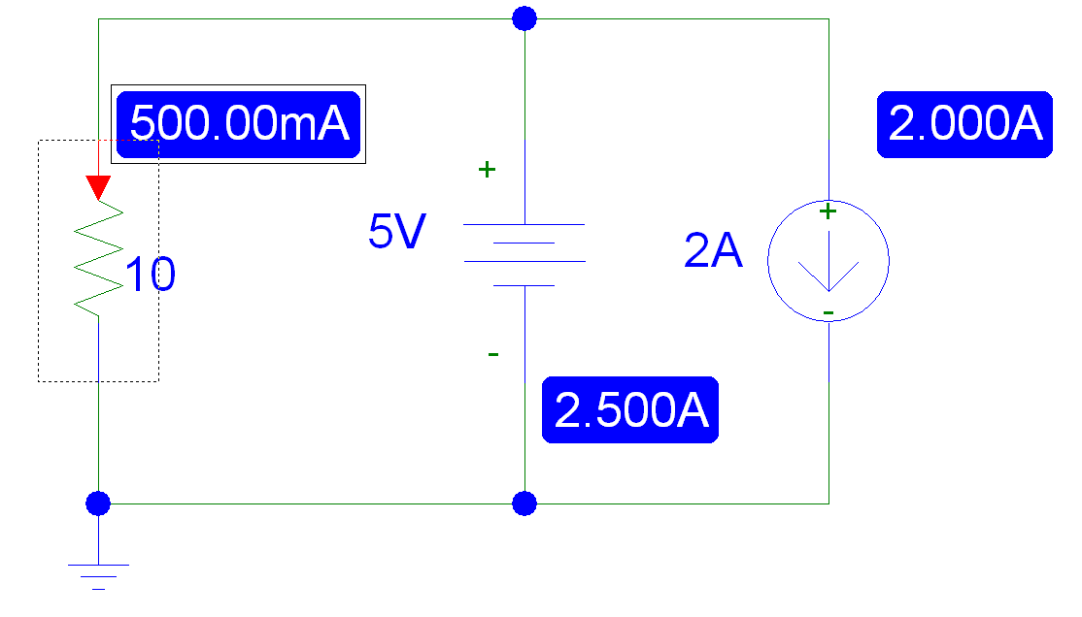
…Example 01

Slide 16
Summary
The property of linearity can be applied when there are only linear components in the circuit.
Resistors, capacitors, inductors
Linear voltage and current supplies
The property is used to separate contributions of several sources in a circuit to the voltages across and the currents through components in the circuit.
Superposition

Slide 17

Example 2
For the circuit, find I₀ when v_{s} = 12 V and v_{s} = 24 V.
Apply KVL to the loops,

Slide 18
Example 3
For the circuit, find v₀ when i_{s} = 30 A and i_{s} = 45 A.

Slide 19
Example 4
Assume I₀ = 1 A and use linearity to find the actual value of I₀ in the circuit.

Slide 20
Example 5
For the circuit, assume that V₀ = 1V and use linearity to calculate the actual value of V₀ .

Slide 21
Superposition

Slide 22
Superposition
The voltage across a component is the algebraic sum of the voltages across the component due to each independent source acting upon it.
The current flowing through across a component is the algebraic sum of the current flowing through component due to each independent source acting upon it.

Slide 23
Usage
Separating the contributions of the DC and AC independent sources.
Example:
To determine the performance of an amplifier, we calculate the DC voltages and currents to establish the bias point.
The AC signal is usually what will be amplified.
A generic amplifier has a constant DC operating point, but the AC signal’s amplitude and frequency will vary depending on the application.

Slide 24
Steps
Turn off all independent sources except one.
Voltage sources should be replaced with short circuits
Current sources should be replaced with open circuits
Keep all dependent sources on
Solve for the voltages and currents in the new circuit.
Turn off the active independent source and turn on one of the other independent sources.
Repeat Step 3.
Continue until you have turned on each of the independent sources in the original circuit.
To find the total voltage across each component and the total current flowing, add the contributions from each of the voltages and currents found in Step 3.

Slide 25
A Requirement for Superposition
Once you select a direction for current to flow through a component and the direction of the + /_ signs for the voltage across a component, you must use the same directions when calculating these values in all of the subsequent circuits.

Slide 26
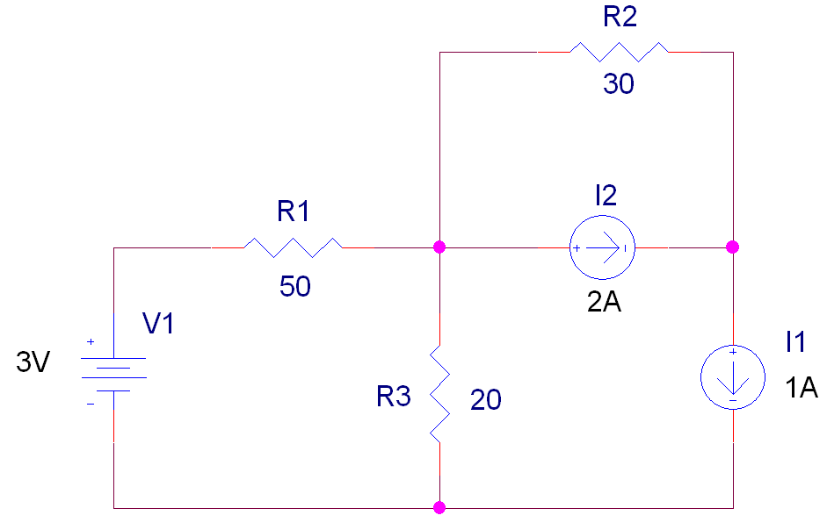
Example 6…

Slide 27
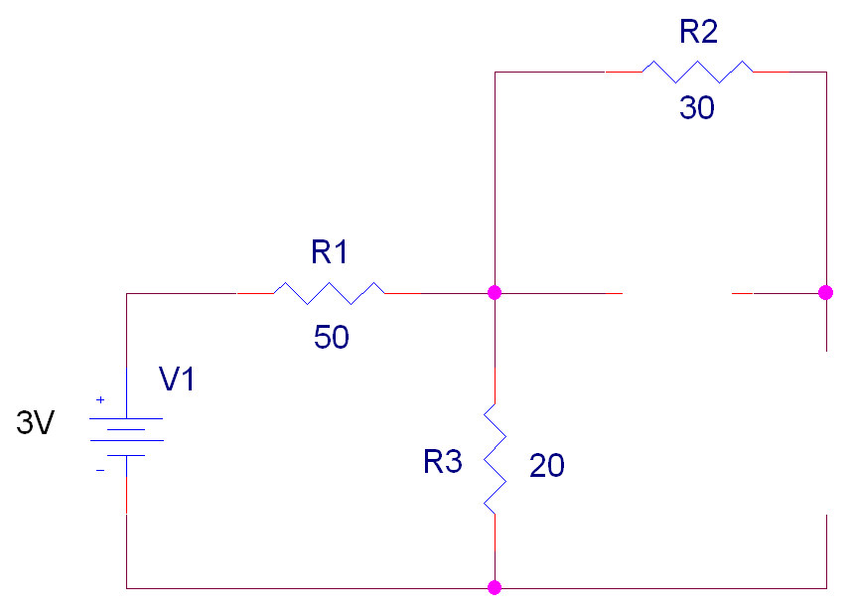
#1: Replace I1 and I2 with Open Circuits
…Example 6…

Slide 28
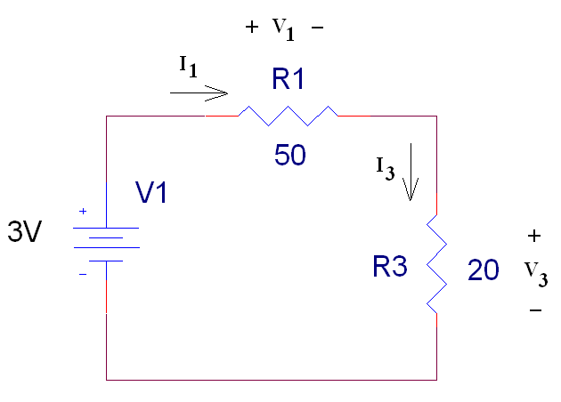
…Example 6…
Since R2 is not connected to the rest of the circuit on both ends of the resistor, it can be deleted from the new circuit.
I₁ = I₃
R_{eq} = R₁ +R₃ = 70W
I₁ = 3V/R_{eq} = 42.9mA
V₁ = [R₁ /R_{eq}]3V (or I₁R₁)
= [50W/70W]3V = 2.14V
V₃ = [R₃ /R_{eq}]3V (or I₃R₃)
= [20W/70W]3V = 0.857V

Slide 29
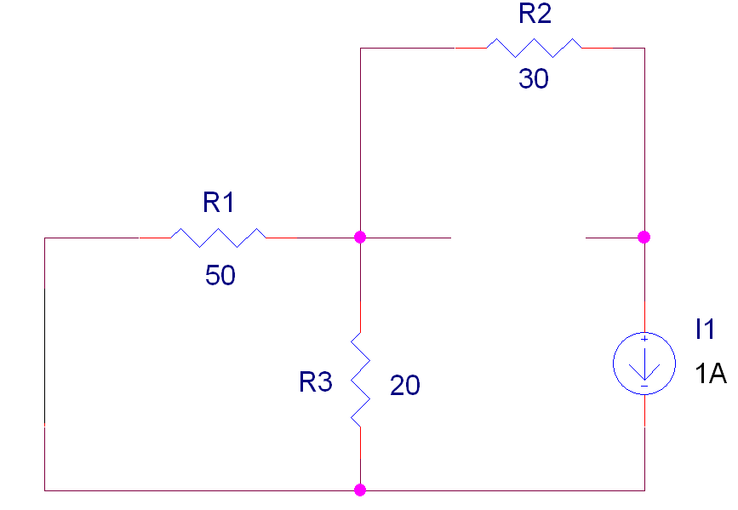
…Example 6…
#2: Replace V1 with a Short Circuit and I2 with an Open Circuit

Slide 30
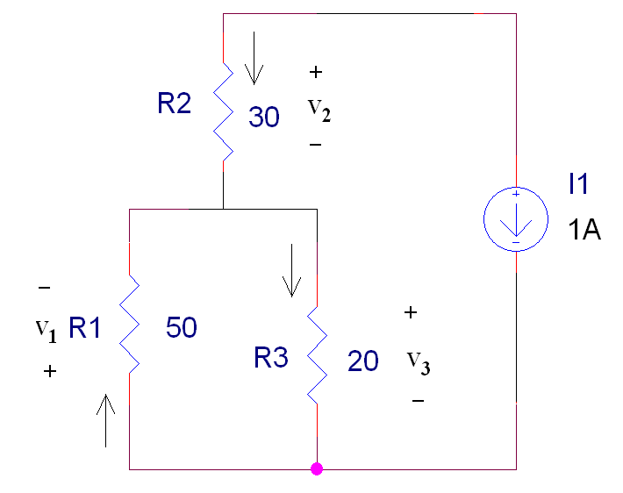
Redrawing Circuit #2
…Example 6…
V₁ = - V₃
I₁ + I₂ = I₃
I₂ = - 1A
R_{eq} = R₂ + R₁ІІR₃
R_{eq} = 44.3W
V₂ + V₃ = R_{eq} I₂ = -44.3V
V₃ = [R₁ІІR₃/ R_{eq}](-44.3V)
V₃ = -14.3V
I₃ = -14.3V/20W = -0.714A
V₁ = 14.3V
V₂ = -30V
I₁ = + 0.286A

Slide 31
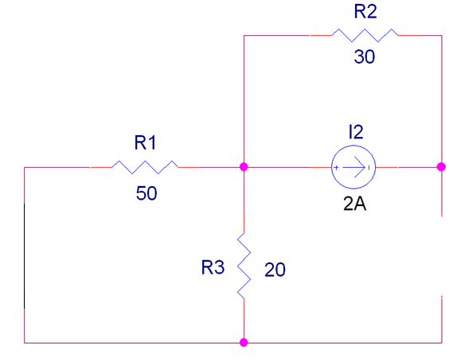
…Example 6…
#3: Replace V1 with a Short Circuit and I1 with an Open Circuit

Slide 32
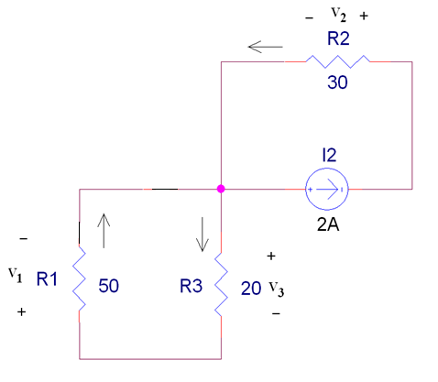
…Example 6…
R2 and I2 are not in parallel with R3
I₁ + I₂ = I₃ + 2A
I₂ = 2A; I₁ = I₃
V₂ = I₂ R₂ = 2A(30W) = 60V
0 = V₁ + V₃ = R₁I₁ + R₁I₁ = - R₃I₃
I₁ = I₃ = 0A
V₁ = 0V
V₃ = 0V

Slide 33
…Example 6
Currents and Voltages in Original Circuit
 | #1 | #2 | #3 | Total
I₁ | +42.9mA | +0.286A | 0A | +0.329A
I₂ | 0 | -1A | 2A | +1A
I₃ | +42.9mA | -0.714A | 0A | -0.671A
V₁ | +2.14V | +14.3V | 0V | 16.4V
V₂ | 0V | -30V | + 60V | +30.0V
V₃ | 0.857V | -14.3V | 0V | -13.4V

Slide 34
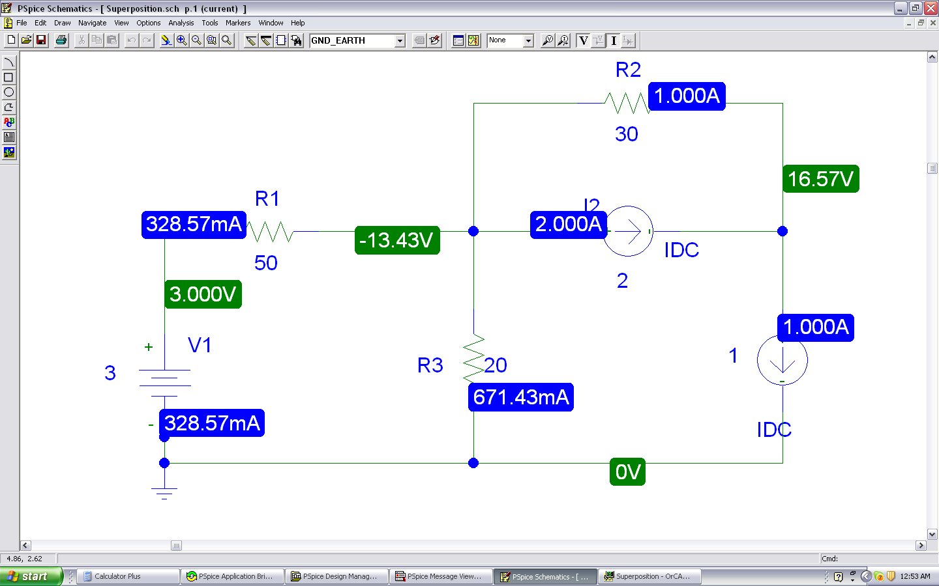
Pspice Simulation

Slide 35
Example 7
Use the superposition theorem to find v in the circuit.

Slide 36
Example 8
Using the superposition theorem, find v₀ in the circuit.

Slide 37
Example 9…
Using the superposition theorem, find i₀ in the circuit.
The circuit involves a dependent source, which must be left intact. We let
According to superposition theorem:
Circuit 1
Circuit 2

Slide 38
…Example 9
Circuit 1
Circuit 2

Slide 39
Source Transformation
Basis for Thevenin and Norton Equivalent Circuits

Slide 40
Source Transformation
We have noticed that series-parallel combination and wye-delta transformation help simplify circuits.
Source transformation is another tool for simplifying circuits.
Basic to these tools is the concept of equivalence.
an equivalent circuit is one whose v-i characteristics are identical with the original circuit.

Slide 41
Source Transformation
A source transformation is the process of replacing a voltage source v_{s} in series with a resistor R by a current source i_{s} in parallel with a resistor R, or vice versa.

Slide 42
Source Transformation
Source transformation also applies to dependent sources, provided we carefully handle the dependent variable.
A dependent voltage source in series with a resistor can be transformed to a dependent current source in parallel with the resistor or vice versa.

Slide 43
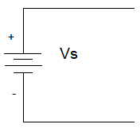
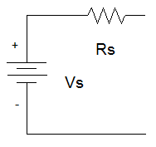
Voltage Sources
Ideal
Real
An ideal voltage source has no internal resistance.
It can produce as much current as is needed to provide power to the rest of the circuit.
A real voltage sources is modeled as an ideal voltage source in series with a resistor.
There are limits to the current and output voltage from the source.

Slide 44
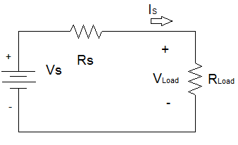
Limitations of Real Voltage Source
I_{L}
V_{L}
R_{L}
Real Voltage Source

Slide 45
Voltage Source Limitations
R_{L} = 0Ω
R_{L} = ∞Ω

Slide 46
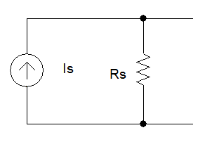
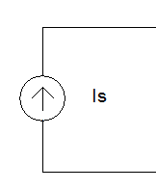
Current Sources
Ideal
Real
An ideal current source has no internal resistance.
It can produce as much voltage as is needed to provide power to the rest of the circuit.
A real current sources is modeled as an ideal current source in parallel with a resistor.
Limitations on the maximum voltage and current.

Slide 47
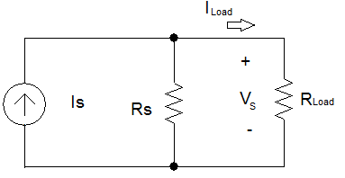
Limitations of Real Current Source
Appear as the resistance of the load on the source approaches Rs.
I_{L}
V_{L}
R_{L}
Real Current Source

Slide 48
Current Source Limitations
R_{L} = 0Ω
R_{L} = ∞Ω

Slide 49
Electronic Response
For a real voltage source, what is the voltage across the load resistor when Rs = RL?
For a real current source, what is the current through the load resistor when Rs = RL?

Slide 50
Equivalence
An equivalent circuit is one in which the i-v characteristics are identical to that of the original circuit.
The magnitude and sign of the voltage and current at a particular measurement point are the same in the two circuits.

Slide 51
Equivalent Circuits
R_{L} in both circuits must be identical.
I_{L} and V_{L} in the left circuit = I_{L} and V_{L} on the left
I_{L}
I_{L}
1
V_{L}
R_{L}
V_{L}
R_{L}
2
Real Voltage Source
Real Current Source

Slide 52
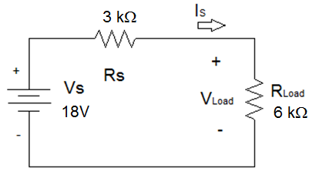
Example 10…
Find an equivalent current source to replace Vs and Rs in the circuit below.
I_{L}
R_{L}
V_{L}

Slide 53
…Example 10…
Find I_{L} and V_{L}.
I_{L}
R_{L}
V_{L}

Slide 54
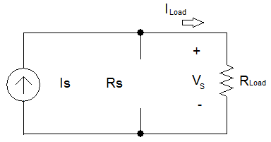
…Example 10…
There are an infinite number of equivalent circuits that contain a current source.
If, in parallel with the current source, Rs = ∞ Ω
Rs is an open circuit, which means that the current source is ideal.
I_{L}
V_{L}
R_{L}

Slide 55
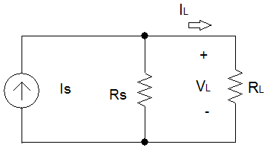
…Example 10…
If R_{S} = 20 kΩ

Slide 56
…Example 10…
If R_{S} = 6 kΩ

Slide 57
…Example 10…
If R_{S} = 3 kΩ

Slide 58
…Example 10
Current and power that the ideal current source needs to generate in order to supply the same current and voltage to a load increases as R_{S} decreases.
Note: Rs can not be equal to 0 Ω.
The power dissipated by R_{L} is 50% of the power generated by the ideal current source
when R_{S} = R_{L}.

Slide 59
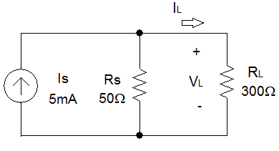
Example 11…
Find an equivalent voltage source to replace Is and Rs in the circuit below.

Slide 60
…Example 11…
Find I_{L} and V_{L}.

Slide 61
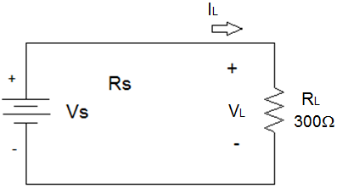
…Example 11…
There are an infinite number of equivalent circuits that contain a voltage source.
If, in series with the voltage source, Rs = 0 Ω
Rs is a short circuit, which means that the voltage source is ideal.

Slide 62
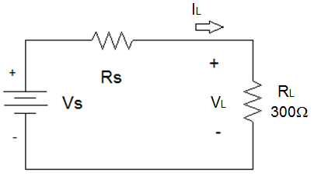
…Example 11…
If R_{S} = 50 Ω

Slide 63
…Example 11…
If R_{S} = 300 Ω

Slide 64
…Example 11…
If R_{S} = 1 kΩ

Slide 65
…Example 11
Voltage and power that the ideal voltage source needs to supply to the circuit increases as R_{S} increases.
Note: Rs can not be equal to ∞ Ω.
The power dissipated by R_{L} is 50% of the power generated by the ideal voltage source
when R_{S} = R_{L}.

Slide 66
Summary
An equivalent circuit is a circuit where the voltage across and the current flowing through a load R_{L} are identical.
As the shunt resistor in a real current source decreases in magnitude, the current produced by the ideal current source must increase.
As the series resistor in a real voltage source increases in magnitude, the voltage produced by the ideal voltage source must increase.
The power dissipated by R_{L} is 50% of the power produced by the ideal source when R_{L} = R_{S}.

Slide 67
Example 12
Use source transformation to find v₀ in the circuit.
Use current division
or

Slide 68
Example 13
Use source transformation to find i₀ in the circuit.

Slide 69
Thévenin and Norton Equivalents

Slide 70
Thévenin & Norton Equivalents
L. C. Thévenin -- French engineer; published his theorem in 1883
E. L. Norton -- scientist with Bell Telephone Laboratories
Any linear circuit network at two terminals may be replaced with a Thévenin equivalent (V_{TH}, R_{TH}) or a Norton equivalent (I_{N}, R_{N}).
The equivalent will behave the same as the original network (v_{L}, i_{L}) with respect to those two terminals.

Slide 71
Thévenin Equivalent, Method 1
Determining V_{TH} and R_{TH} with respect to two terminals:
Use repeated source transformations to arrive at a single voltage source in series with a single series resistance.

Slide 72
Example 14
Determine the Thévenin equivalent of Network A, and compute the power delivered to the load resistor R_{L}.
Power delivered to the load

Slide 73
Thévenin Equivalent, Method 2
Determining V_{TH} and R_{TH} with respect to two terminals:
Open the load and determine the open-circuit voltage (V_{OC}), then short the load and determine the short-circuit current (I_{SC}).

Slide 74
Example 15
Determine the Thévenin equivalent of Network A using open-circuit voltage and short-circuit current.
I_{M}
I_{SC}
I_{M} = 12 / (3+7||6) = 1.9259 A
I_{SC} = (1.9259×6) / 13 = 0.8889 A
R_{TH} = V_{OC} / I_{SC} = 8/0.8889 = 9 Ω
V_{TH} = V_{OC} = 8 V

Slide 75
Thévenin Equivalent, Method 3
Determining V_{TH} and R_{TH} with respect to two terminals:
Open the load and determine the open-circuit voltage (V_{OC}), then deactivate all independent sources (short-circuit the V sources and open-circuit the I sources) and find the equivalent resistance (R_{eq}).

Slide 76
Example 16
Determine the Thévenin equivalent of Network A by deactivating the independent sources.
R_{TH} = 7+(6||3) = 9 Ω
V_{TH} = V_{OC} = 8 V

Slide 77
Thévenin Equivalent, Method 4
Determining V_{TH} and R_{TH} with respect to two terminals:
Open the load and determine the open-circuit voltage (V_{OC}), then deactivate all independent sources and apply a test source. V_{TH} = V_{OC} R_{TH} = V_{test} / I_{test}
The only solution method for finding V_{TH} and R_{TH} (of the 4 presented in the prior slides) that is guaranteed to work when the circuit includes dependent sources is the test-source method.

Slide 78
Example 17
Determine the Thévenin equivalent of Network A by using a test source.
I_{test} = 1 / (7+6||3) = 0111 A
R_{test} = V_{test} / I_{test} = 1/0.111 = 9 Ω

Slide 79
Example 18
Determine the Thévenin and Norton equivalent circuits for the network faced by the 1 kΩ resistor.
R_{TH} = 5 kΩ
Using superposition:
V_{oc|4v} = 4 V
V_{oc|2mA} = 0.002×2000 = 4 V
V_{oc} = V_{oc|4v} + V_{oc|2mA} = 4 + 4 = 8 V
Thévenin
Norton

Slide 80
Example 19
Determine the Thévenin and Norton equivalents of the circuit.

Slide 81
Example 20
Determine the Thévenin equivalent of this network at the open-circuit terminals.
To find V_{OC} we note that v_{X} = V_{OC} and that the dependent source current must pass through the 2 k resistor, since no current can flow through the 3 k resistor.
The dependent source prevents us from determining R_{TH} directly for the inactive network through resistance combination; we therefore seek I_{SC}.
Upon short-circuiting the output terminals, it is apparent that v_{x} = 0 and the dependent current source is not active.

Slide 82
Example 21
Find the Thévenin equivalent of this circuit.
The rightmost terminals are already open-circuited, hence i = 0.
Consequently, the dependent source is inactive, so v_{oc} = 0.
We apply a 1 A source externally, measure the voltage V_{test}
Thevenin equivalent

Slide 83
Power from a Practical Source
The power delivered to a load from a practical voltage source is

Slide 84
Maximum Power Transfer

Slide 85
Example 22
The circuit shown in below is a model for the common-emitter bipolar junction transistor amplifier.
Choose a load resistance so that maximum power is transferred to it from the amplifier, and calculate the actual power absorbed.

Slide 86
Example 23
Find i₀ in the circuit using superposition.

Slide 87
Example 24
Find v_{x} in the circuit using source transformation.

Slide 88
Example 25
Find the Thévenin equivalent of this circuit.

Slide 89
Example 25
Find the value of R_{L} for maximum power transfer in the circuit.
Find the maximum power.

